Slide 1
Large-Scale and Multi-Structured Databases Project Design My Vacation
Lorenzo Bataloni
Claudio Daka
Edoardo Pantè

Slide 2
Application Highlights
The My Vacation application is designed to book accomodations and activities.
The main features of the application are:
Host can publish, edit or remove an advertisement (accommodation or activity)
Users can book an accommodation or an activity
Users can review an accomodation or an activity
Users can report an accommodation or an activity
Each user can add accomodation or activity in his personal wishlist
Admin can manage users, host and reviews.
Admin can approve or disapprove an advertisement.
Admin can have access to analytics about application and advertisement.

Slide 3
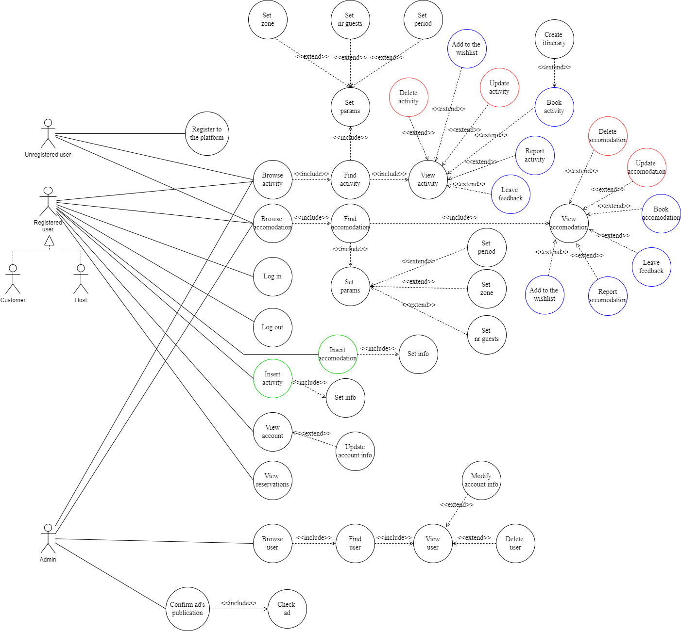
Actors and main supported functionalities

Slide 4
Dataset Description
Source:
http://data.insideairbnb.com/italy/puglia/puglia/2022-09-26/data/listings.csv.gz
https://randomuser.me
https://www.kaggle.com/datasets/jessemostipak/hotel-booking-demand
Description: AirBnb accomodation list in Puglia, Italy.
Volume: 800MB.
Variety: We have multiple sources for accomodations dataset.

Slide 5
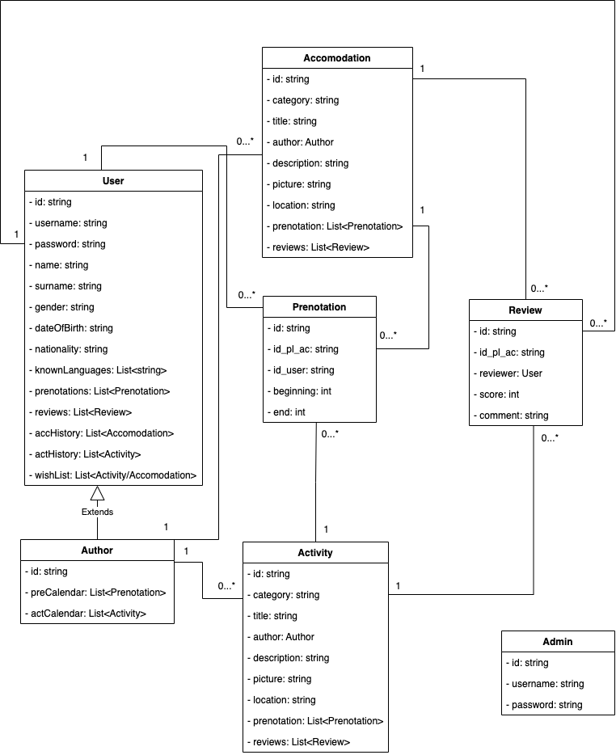
Preliminary UML Class Diagram

Slide 6
Requirements and Entities handled by Document DB
Entities:
User
Accomodation
Review
Activity
Prenotation
Admin
Queries:
Show advertisement filtered by city, period and number of guests.
Show advertisement with highest average rating.
Show number of registered users.
Show advertisement to be approved.
Show reviews for specific advertisement.
Show own advertisement with higher number of prenotations.
Show users filtered by username.

Slide 7
Requirements and Entities handled by Graph DB
Entities:
User
Accomodation
Activity
City
Queries:
Show suggested accomodations/activities based on city.
Show suggested accomodations/activities based on saved accomodations/activities.
Show itinerary with visited accomodations/activities made by user.
Show the most prenoted accomodations/activities for each city.
Show the most saved accomodations/activities.
Show the most visited cities.
Show the most reported accomodations/activities.

Slide 8
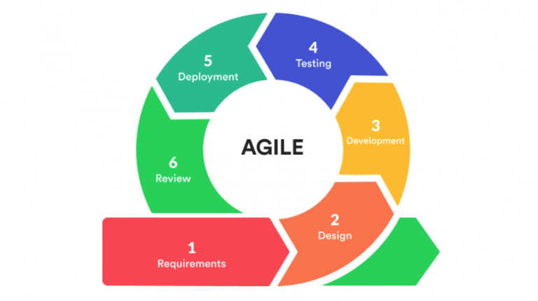
Software Architecture Preliminary Idea
Programming Languages:
Python
JavaScript
Frameworks:
Flask
Node.js
ReactJS
DMBSs:
MongoDB
Neo4J

